Slide 1

Machine learning and Deep Neural Networks for Short term Solar Power Forecasting

Slide 2
Table of contents
Introduction
Input Data Visualization
Different types of Models
Conclusion
Further roadmap
References

Slide 3
Introduction
Pipeline for Machine learning model:
Data collection and processing
Deciding the model
Training
the Model
Save the model
Testing the model

Slide 4
Input Data Visualization
Input data:
temperature
Irradiance
power
pressure
Wind
direction
Wind
speed
PVOD
Ten stations data and Meta data
Six features15 min time stamp
49.34GW
Features
Tiechui Yaoa,b, Jue Wanga,b , Haoyan Wuc , Pei Zhangcd, Shigang Lie , Yangang Wanga,b, Xuebin Chia,b, Min Shi,”A photovoltaic power output dataset: Multi-source photovoltaic power output dataset with Python toolkit”,ResearchGate Article in Solar Energy · December 2021,DOI: 10.1016/j.solener.2021.09.050

Slide 5
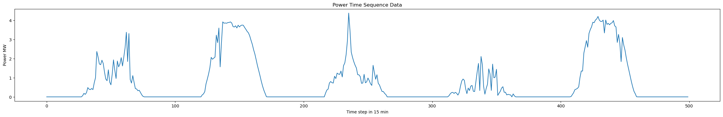
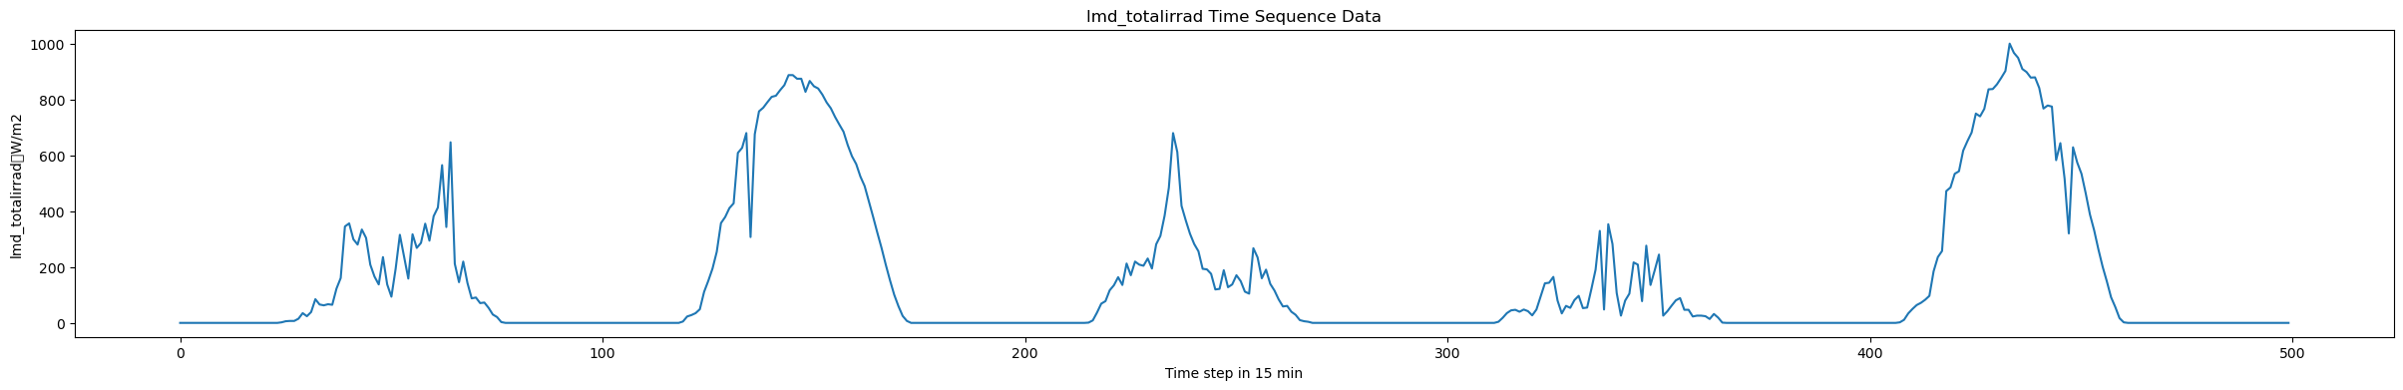
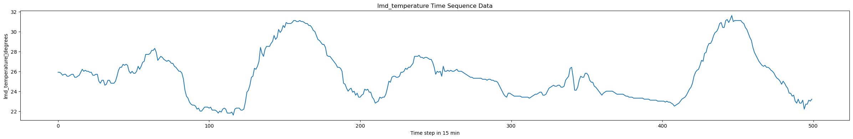
Input Data Visualization
49.34GW

Slide 6
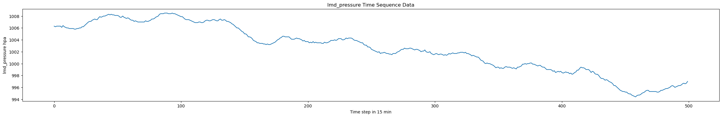
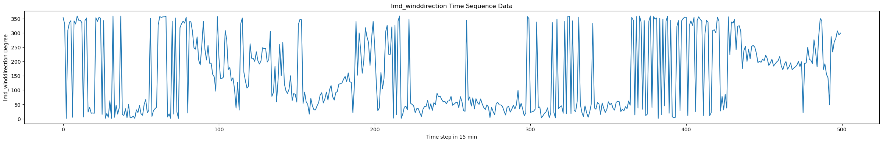
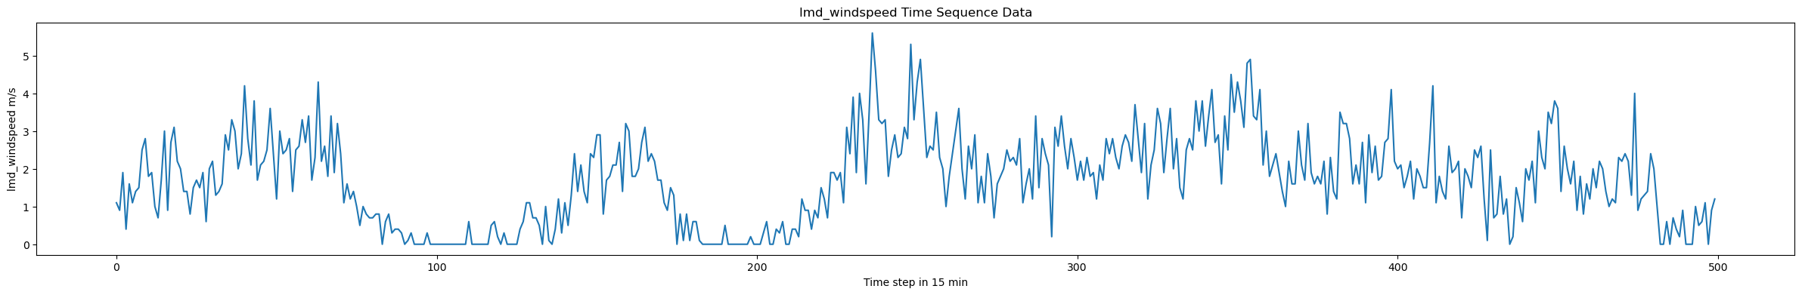
Input Data Visualization
49.34GW

Slide 7
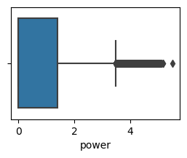
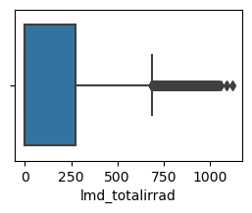
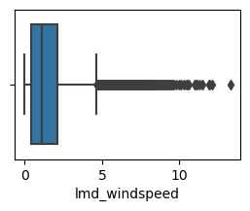
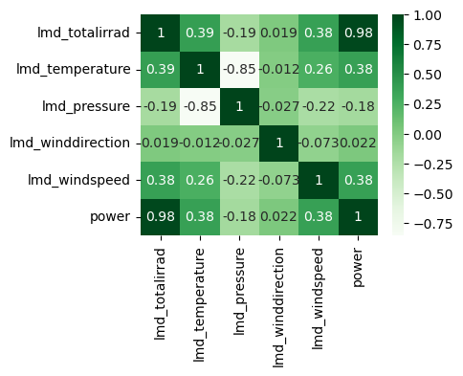
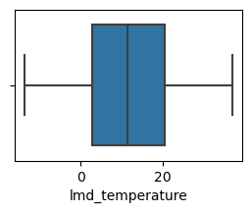
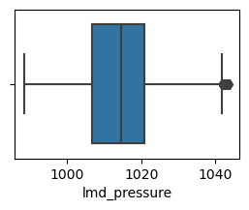
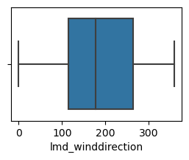
Input Data Visualization
Box plots
Heat Map
49.34GW

Slide 8
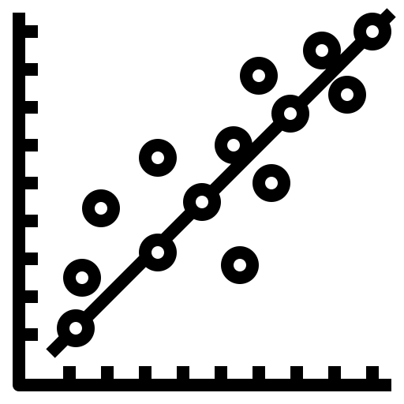
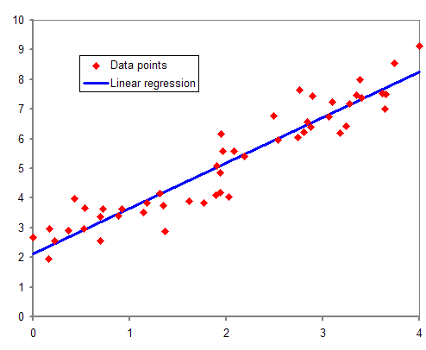


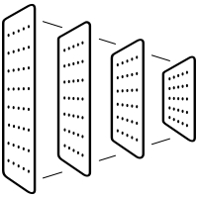
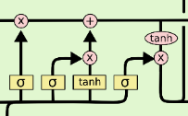
Different types of Models
Multi-variable regression for Power output
MLP with 5 features as Input power as Output
MLP with Power as Input and Power as Output
MLP with all features as Input and all features as Output
Different models for PV power forecasting
Convolution neural network all features as Input all are Output
LSTM with all features as Input and all features as Output

Slide 9



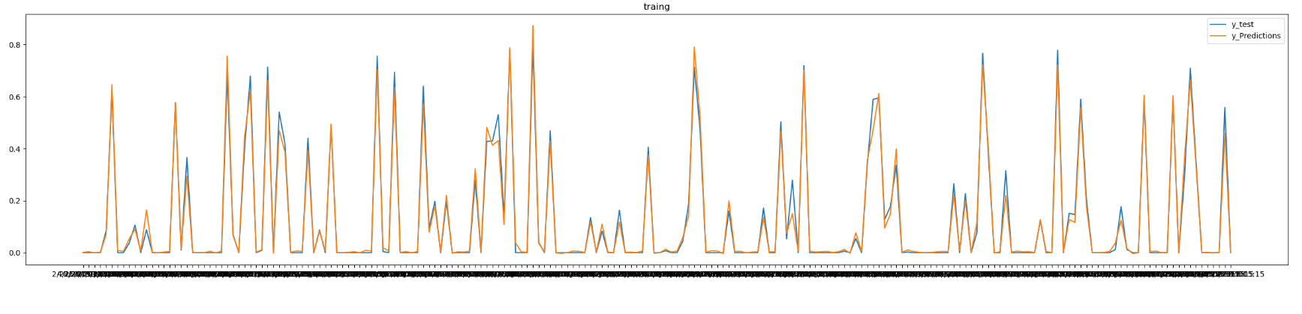
Different types of Models
1. Multivariable regression for PV Output
Advantage:
Accuracy is good
Easy to implement
Disadvantage:
We require input data for every time instant
Wind
direction
-0.0078*c+0.9835*Irradiance-0.0004*tem+0.0123*pressure+0.0048*wind_direction+0.0342*windspeed
temperature
Power
49.34GW
Wind speed
Irradiance
Tool:
Language:
pressure
Fig.1-multi variable regression
r2:0.956
r2:0.954
Fig.1-Training and Testing

Slide 10

Different types of Models
2.MLP five features as Input power as Output
Input data pattern
Model architecture
Input features |  |  |  |  | output
Irradiance (x1) | Temperature (X2) | pressure (X3) | Wind direction (X4) | Wind speed (X5) | Power (Y1)
Xn1 | Xn2 | Xn3 | Xn4 | Xn4
W
V
X1
X2
X3
X4
x5
49.34GW
U
Y1
Language:
Tool:
Loss Function: RMSE
Optimizer: ADAM

Slide 11
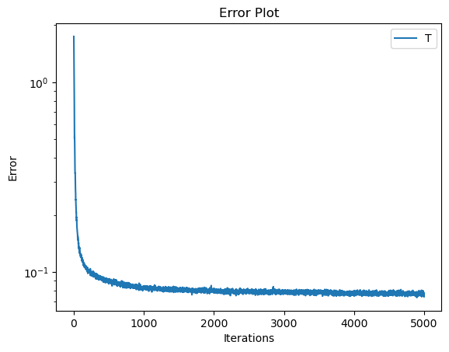
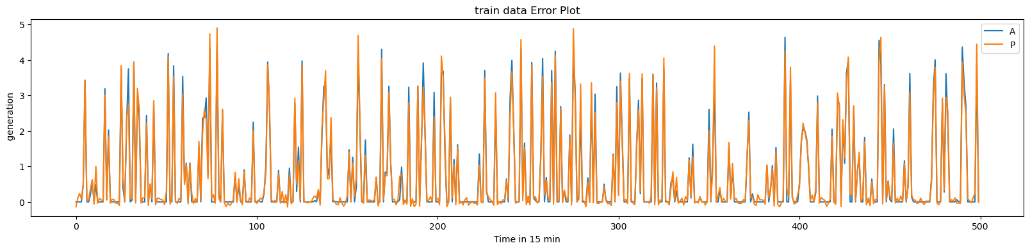
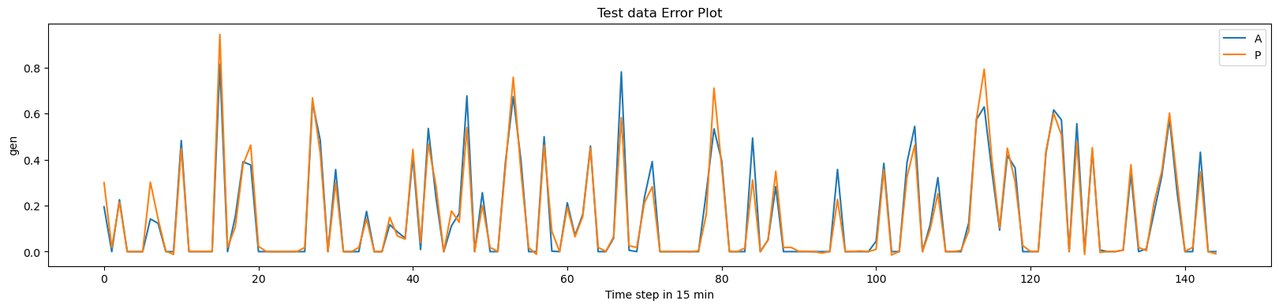
Different types of Models
2. MLP five features as Input power as Output
Training
Testing
Disadvantage:
We require input data for every time instant
MLP with 5 features as Input power as Output
number | Hidden layer | learning rate | activation | epochs | RMSE_train | RMSE_test
1 | 3(10,7,5) | 0.005 | ReLu | 5000 | 0.292 | 0.0116
2 | 3(10,7,5) | 0.005 | Sigmoidal | 5000 | 0.379 | 0.0115
3 | 3(50,30,50) | 0.005 | Tanh | 10000 | 0.318 | 0.0116
4 | 2(5,7) | 0.005 | ReLu | 10000 | 0.258 | 0.0115
5 | 4(30,20,7) | 0.005 | ReLu | 10000 | 0.27 | 0.0116

Slide 12
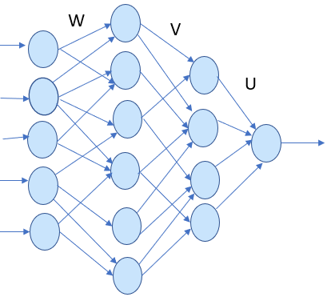
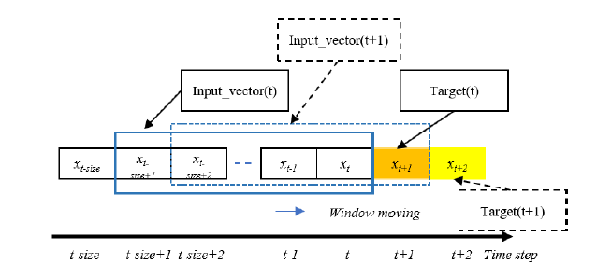

Different types of Models
3. MLP with Power as Input and Power as Output
Data Sampling
Pattern Preparation
Model
Input features |  |  |  |  | Output
P1 | P2 | P3 | P4 | P5 | P6
P2 | P3 | P4 | P5 | P6 | P7
P3 | P4 | P5 | P6 | P7 | P8
P4 | P5 | P6 | P7 | P8 | P9
P5 | P6 | P7 | P8 | P9 | P10
P1
P2
P3
P4
P5
P6
Time window: 5
Loss Function: RMSE
Optimizer: ADAM

Slide 13
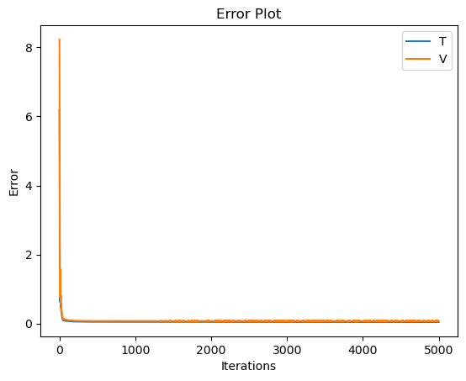
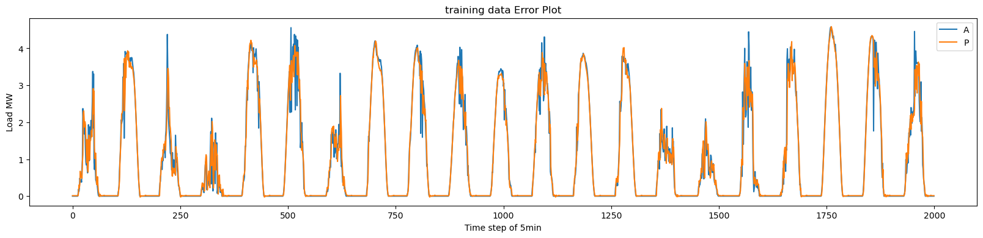
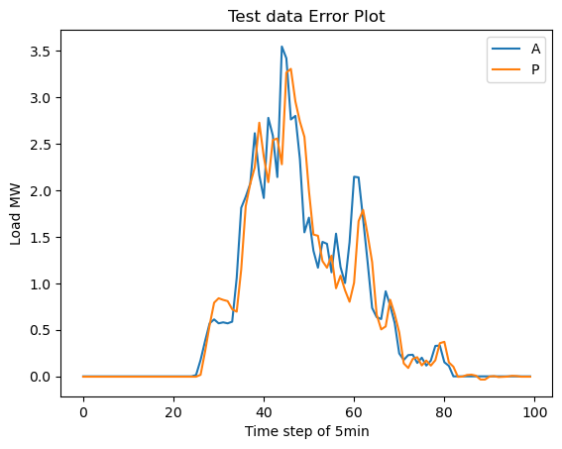
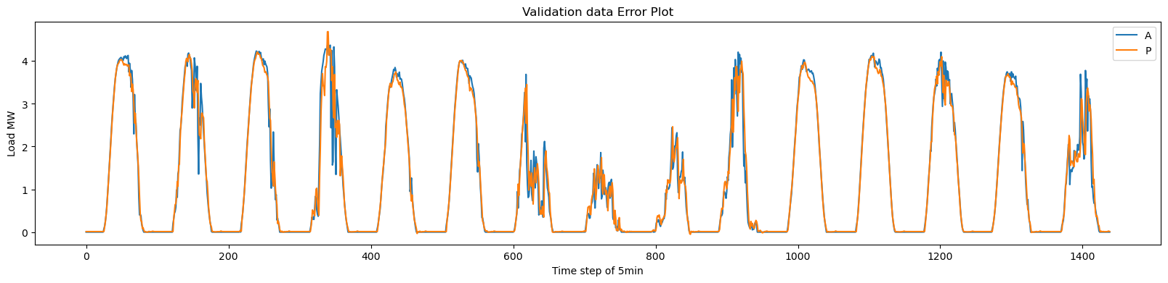
Different types of Models
3.MLP with Power as Input and Power as Output
Training
Time stamp15nmin
T
Validation
Timestamp 15 min
MLP Power as input power as output
Number | Hidden layers | Learning rate | Activation | Window | Epochs | RMSE_training | RMSE_tesing | RMSE_val
1 | 3(30,25,5) | 0.001 | Relu | 10 | 5000 | 0.326 | 0.3029 | 0.85
2 | 4(40,35,25,5) | 0.001 | Relu | 10 | 5000 | 0.282 | 0.302 | 0.35
3 | 2(25,5) | 0.001 | Relu | 10 | 5000 | 0.324 | 0.294 | 0.37
4 | 3(30,25,5) | 0.001 | Tanh | 10 | 5000 | 0.26 | 0.2838 | 0.303
5 | 3(30,25,5) | 0.001 | sigmoidal | 10 | 5000 | 0.421 | 0.2878 | 0.485
6 | 3(30,25,5) | 0.001 | sigmoidal | 15 | 5000 | 0.589 | 0.2977 | 0.695
7 | 3(30,25,5) | 0.001 | sigmoidal | 10 | 5000 | 0.26 | 0.2868 | 0.311
8 | 3(30,25,5) | 0.001 | Relu | 10 | 5000 | 0.234 | 0.294 | 0.293

Slide 14
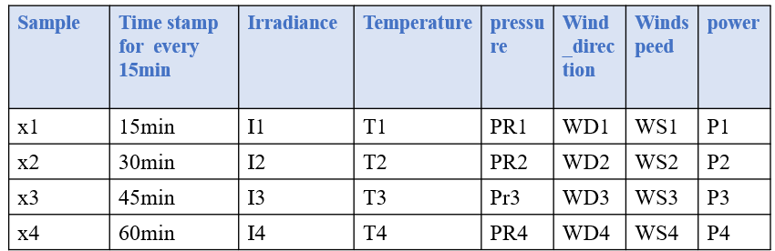
Different types of Models
4. MLP with all features as Input and all features as Output
Data Sampling
Pattern Preparation
Input |  | Output
X1 | X2 | X3
X2 | X3 | X4
X4 | X5 | X6
Time window:2

Slide 15
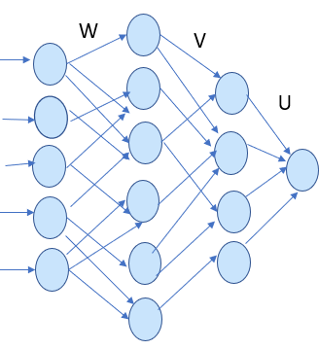
Different types of Models
4. MLP with all features as Input and all features as Output
Model
W1
T1
H1
D1
G1
P1
W2
T2
H2
D2
G2
P2
W3
T3
H3
D3
G3
P3
Loss Function: RMSE
Optimizer: ADAM

Slide 16
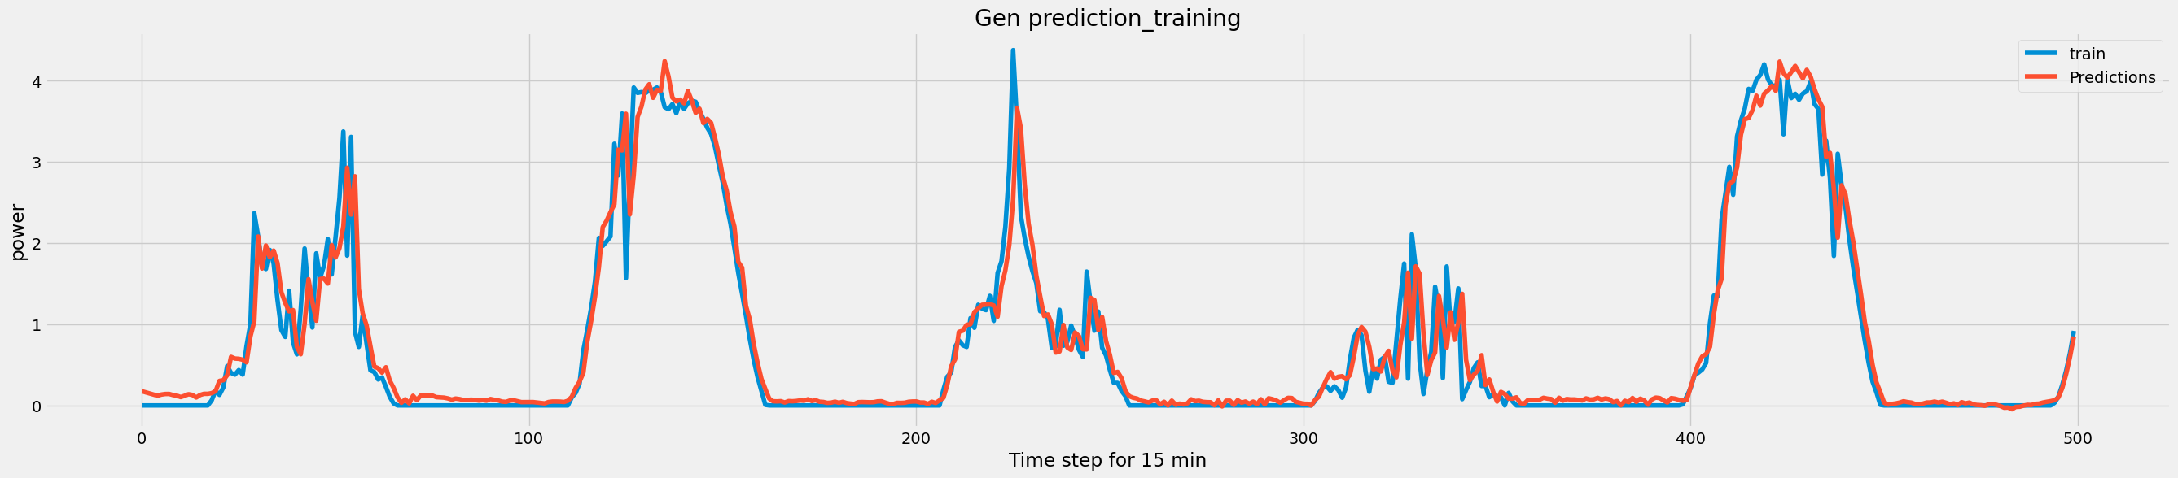
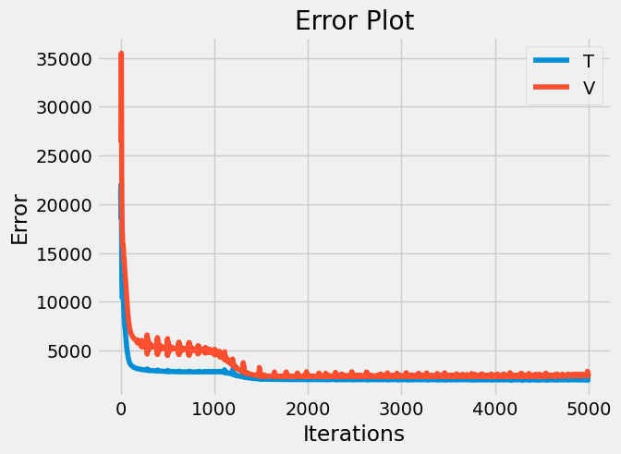
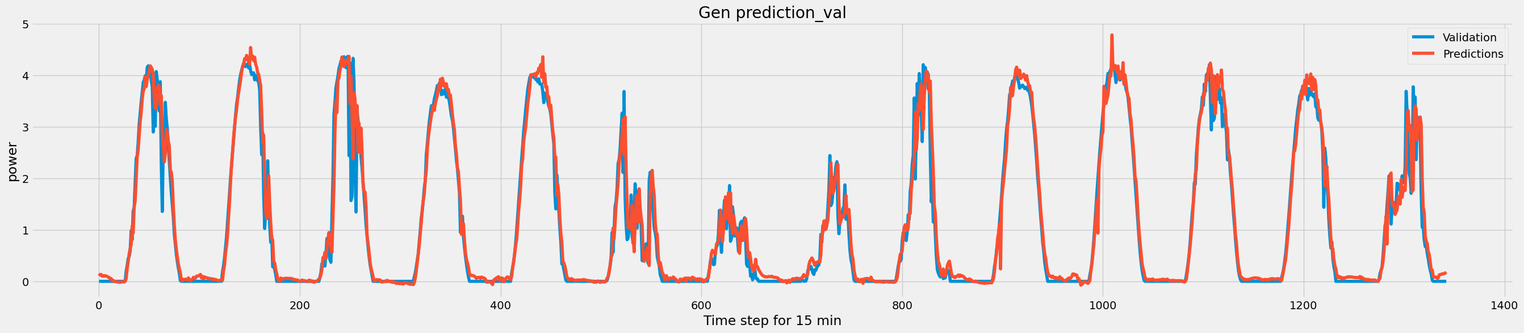
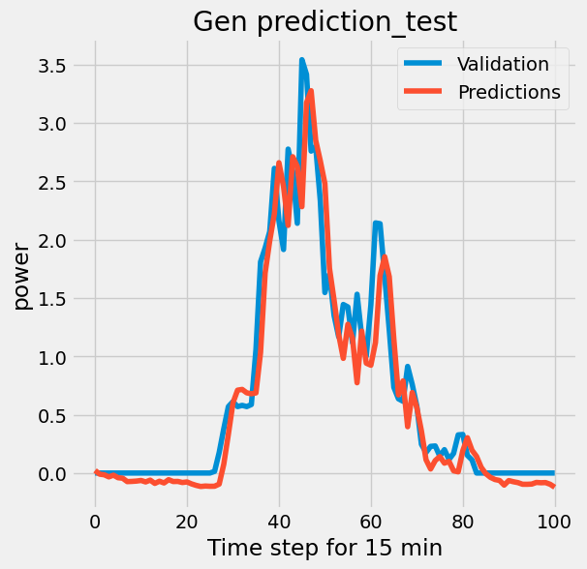
Different types of Models
4. MLP with all features as Input and all features as Output
MLP with all features as in put all features as out put (window technique)
number | Hidden Layers | Learning rate | activation | window | epochs | epochs | RMSE_training | RMSE_tesing | RMSE_val
1 | 3(90,70,10) | 0.001 | Relu | 10 | 5000 | 5000 | 0.2258 | 0.2826 | 0.2857
2 | 4(90,70,45,10) | 0.001 | Relu | 10 | 5000 | 5000 | 0.2545 | 0.3203 | 0.295
3 | 4(150,90,45,20) | 0.001 | Relu | 20 | 5000 | 5000 | 0.2213 | 0.3162 | 0.2887
4 | 3(90,70,10) | 0.005 | Relu | 10 | 5000 | 5000 | 0.2398 | 0.2862 | 0.2963
5 | 3(90,70,10) | 0.005 | Relu | 20 | 5000 | 5000 | 0.2482 | 0.3049 | 0.3099
6 | 3(90,70,10) | 0.001 | Tanh | 10 | 5000 | 5000 | 0.2224 | 0.2748 | 0.2838
7 | 4(150,90,45,20) | 0.001 | Tanh | 20 | 5000 | 5000 | 0.2214 | 0.2837 | 0.3047
8 | 3(90,70,10) | 0.001 | sigmoidal | 10 | 5000 | 5000 | 0.2218 | 0.285 | 0.284

Slide 17
Different types of Models
5. Convolution Neural Network with all features as Input and all features as Output
Data Sampling
Pattern Preparation
Input |  | Output
X1 | X2 | X3
X2 | X3 | X4
X4 | X5 | X6
Time window:2

Slide 18
Different types of Models
5. Convolution Neural Network with all features as Input and all features as Output
Model
I3
T3
PR3
WD3
WS3
P3
Input
Filter
Convolution
SoftMax
Dense

Slide 19
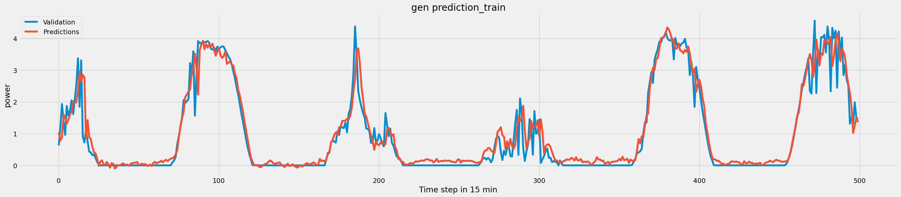
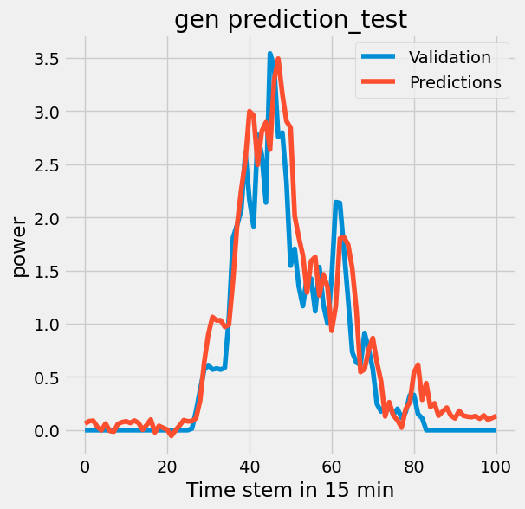
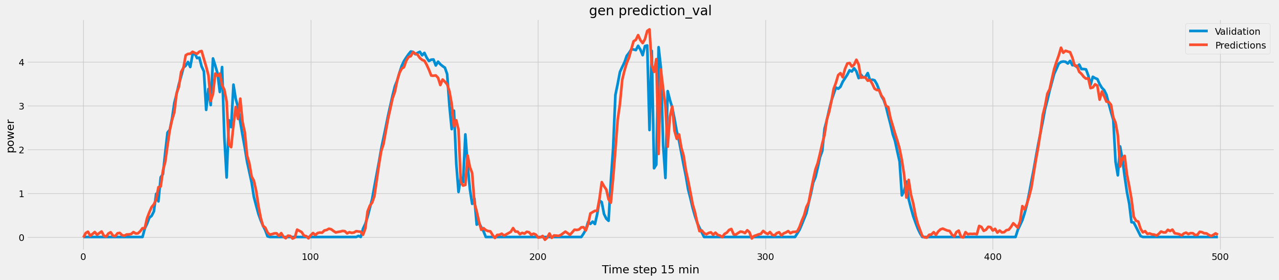
Different types of Models
5 . Convolution Neural Network with all features as Input and all features as Output
Convolution Neural Network
number | convolution, Hidden_layer | Learning rate | Learning rate | activation | window | epochs | epochs | RMSE_training | RMSE_testing | RMSE_val
1 | 5(10,3),1(30) | 0.0001 | 0.0001 | Relu | 200 | 200 | 200 | 0.2596 | 0.3083 | 0.3503
2 | 2(10,3),1(30) | 0.0001 | 0.0001 | Relu | 100 | 200 | 200 | 0.2346 | 0.3013 | 0.3
3 | 4(30,20,10,10,3),1(30) | 0.0001 | 0.0001 | Relu | 300 | 200 | 200 | 0.254 | 0.3481 | 0.381
3 | 4(30,20,10,10,3),1(30) | 0.001 | 0.001 | Relu | 300 | 200 | 200 | 0.2606 | 0.3076 | 0.3724
4 | 4(30,20,10,10,3),1(30) | 0.001 | 0.001 | Relu | 90 | 200 | 200 | 0.2687 | 0.3818 | 0.3433
5 | 4(30,20),1(30) | 0.001 | 0.001 | Relu | 90 | 200 | 200 | 0.2575 | 0.3148 | 0.3342
6 | 4(10,10,10),1(45,30) | 0.001 | 0.001 | Relu | 90 | 200 | 200 | 0.2802 | 0.2702 | 0.3241
7 | 4(10,10,10),1(45,30) | 0.001 | 0.001 | Relu | 70 | 200 | 200 | 0.2545 | 0.294 | 0.3044
8 | 4(10,10,10),1(45,30) | 0.001 | 0.001 | tanh | 70 | 200 | 200 | 0.2546 | 0.3166 | 0.301
9 | 5(10,10,10,10,10),2(45,30) | 0.001 | 0.001 | tanh | 50 | 200 | 200 | 0.262 | 0.3459 | 0.333

Slide 20

Different types of Models
6. LSTM with all features as Input and all features as Output
Data Sampling
Pattern Preparation
Sample | Time stamp for every 15min | Irradiance | Temperature | pressure | Wind_direction | Windspeed | power
x1 | 15min | I1 | T1 | PR1 | WD1 | WS1 | P1
x2 | 30min | I2 | T2 | PR2 | WD2 | WS2 | P2
x3 | 45min | I3 | T3 | Pr3 | WD3 | WS3 | P3
x4 | 60min | I4 | T4 | PR4 | WD4 | WS4 | P4
Input data(window :5) |  |  |  |  | Out put
x1 | x2 | x3 | x4 | x5 | X6
x2 | x3 | x4 | x5 | x6 | x7
x3 | x4 | x5 | x6 | x7 | x8
x4 | x5 | x6 | x7 | x8 | x9
x5 | x6 | x7 | x8 | x9 | x10
Time window:5

Slide 21










Different types of Models
6.LSTM with all features as Input and all features as Output
Model
$$x_{t+5}$$
$$c_{t−1}$$
LSTM
LSTM
LSTM
LSTM
LSTM
$$h_{t−1}$$
$$c_{t−1}$$
LSTM
LSTM
LSTM
LSTM
LSTM
$$h_{t−1}$$
x$t$
$$x_{t+1}$$
$$x_{t+2}$$
$$x_{t+3}$$
$$x_{t+4}$$

Slide 22
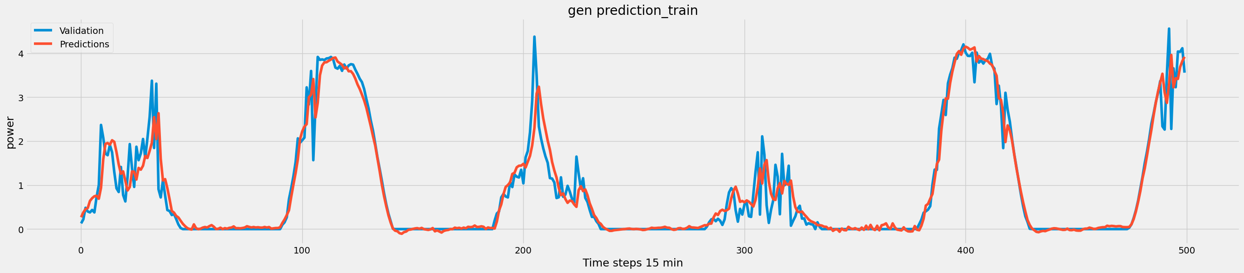
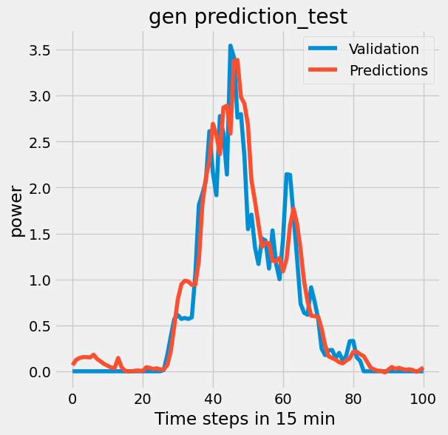
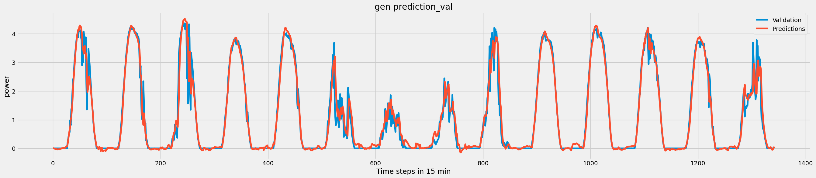
Different types of Models
6.LSTM with all features as Input and all features as Output
LSTM all features are input all features are output
number | LSTM,dense | Learning rate | activation | window | epochs | RMSE_training | RMSE_testing | RMSE_val
1 | 2(40,40),1(30) | 0.0005 | relu | 10 | 100 | 0.2453 | 0.3214 | 0.304
2 | 2(100,100),1(30) | 0.0005 | relu | 20 | 100 | 0.2325 | 0.316 | 0.2902
3 | 2(100,100),1(30) | 0.001 | relu | 50 | 100 | 0.234 | 0.3368 | 0.2947
4 | 2(100,100),1(50,30) | 0.001 | relu | 50 | 100 | 0.2247 | 0.3256 | 0.2871
5 | 2(200,150,40),1(50,30) | 0.001 | relu | 30 | 100 | 0.2238 | 0.2973 | 0.2905
6 | 2(200,200,200),1(50,30) | 0.001 | relu | 30 | 100 | 0.2207 | 0.263 | 0.2836

Slide 23
Conclusion
For PV power forecasting I have developed and analyzed 6 models and I have compared the results of all models
Out of all the models, I observed that LSTM is performing better and giving good result because it has a memory

Slide 24
Future road map
Developing other new models
Run each model 100 times and take the average of the results
Compare each model and save the best model

Slide 25
References
Chun-Hung LIU1, JYH-Cherng GU1,and Ming-TA YANG(Member, IEEE) “A Simplified LSTM Neural Networks for One Day-Ahead Solar Power Forecasting” in IEEE Open access Journal on Multidisciplinary, doi:10.1109/ACCESS.2021.3053638,2021
Muhammad Naveen Akhter,Saad Mekhilef,Hazlie Mokhlis,Noraisyah Mohamed Shah ”Review on forecasting of Photovoltaic Power generation based on machine learning metaheuristic technique”in IET Journal on Renewable Power Generation,2019
Erhane Darsene DIMD (Graduate Student Member, IEEE), Steve Voller, Umit Cali (Member, IEEE), and Ole-Morten Midtgard , (Member, IEEE) “A Review of Machine Learning-Based Photovoltaic Output Power Forecasting: Nordic Context” in IEEE open access Journal on Multidisciplinary, doi: 10.1109/ACCESS.2022.315694,2019
Mohammad Safayet Hossain, and Hisham Mahmood(Member,IEEE) “Short-Term Photovoltaic Power Forecasting Using an LSTM Neural Network and Synthetic Weather Forecast”in IEEE Open access Journal on Multidisciplinary, doi: 10.1109/ACCESS.2020.3024901,2020
Nahid-AI-Masood,Ahmed Manavi alam,Sohana Rahman deeba “Forcasting of Photovoltaic Power Generation Techniques and key Factors”Proceedings of 2019 IEEE Region 10 Symposium,2019
Chiou-Jye Huang and Ping-Huan Kuo“Multiple input Deep Convolution Neural Network Model for Short term PV load forcasting” IEEE Open access Journal on Advanced Energy Storage Technologies ,doi: 10.1109/ACCESS.2019.2921238,2019
Grzegorz Dudek,Pawel Pelka,and Slawek Smyl “A Hybrid Residual Dilated LSTM and Exponential Smoothing Model for Midterm Electric Load Forecasting” IEEE Transactions on Neural Networks And Learning System ,VOL.33.No.7,July 2022
Udemy Course for Tensorflow 2.O

Slide 26
Thank you

